Slide 1
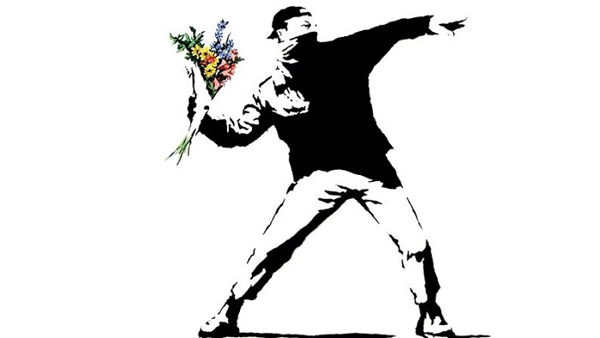
Pro-Test Demo Day Presentation
Creating a safe public space for demonstrations
Noah Darwich, Kevin Lee, Max Höchsmann
10th of June, 2022

Slide 2
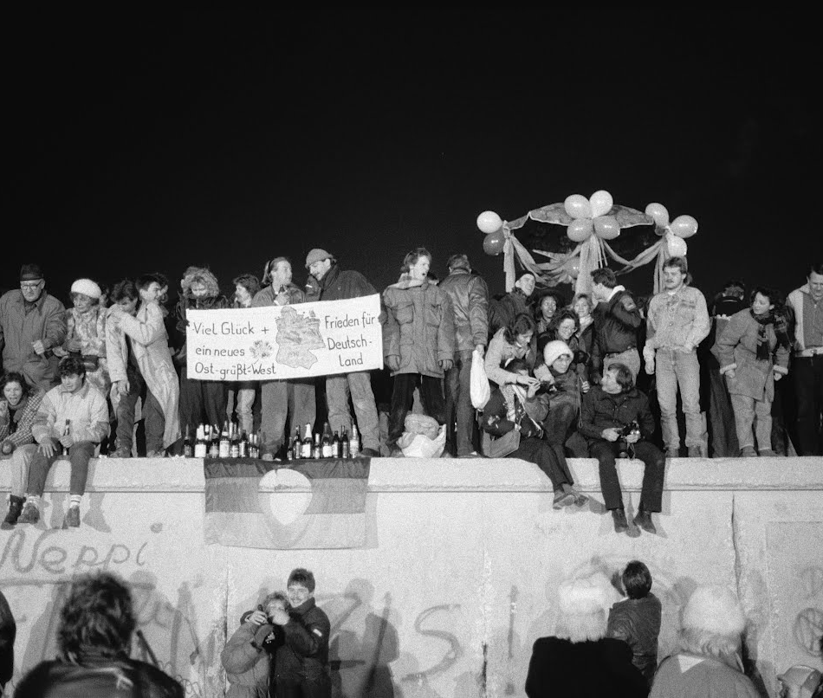
Table of Content
Recap
Methodology
General Insights
Showcase
Outro

Slide 3
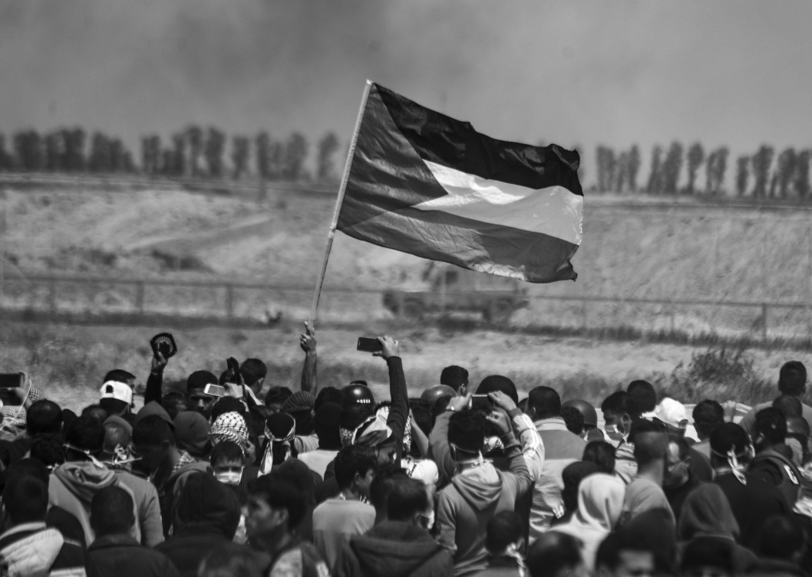
Recap

Slide 4
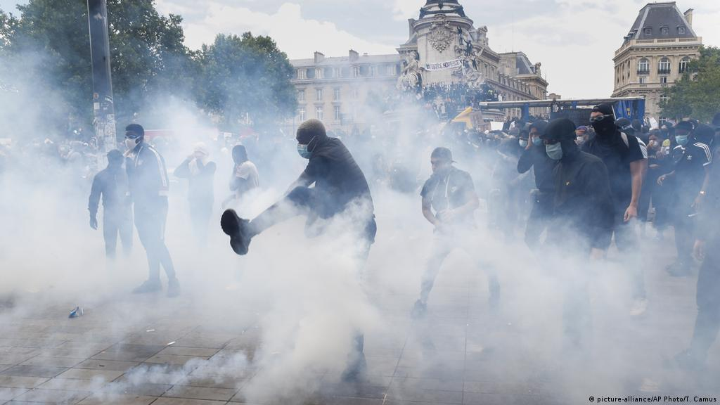
Violence at demonstrations undermines critical civic processes
Protesters face injuries, caused during contact with law enforcement
Many of those injuries are lethal, or untreatable
This causes harm to the well being of citizens and undermines their trust in the political system
So far little emphasis is placed on trying to assess if a protest might turn violent or not
Pro-Test aspires to change this!
Notes:
Problem Statement
Protests often escalate and turn violent, undermining the effectiveness of the protest´s purpose and the legitmacy of the regime as well as harming participants (compare intro slides from Noah´s presentation)
Our tool solves this problem, by…
Prevent physical and psychological harm to participants
Increase effectiveness of demonstrations by making them less violent
Brief pictures/ intro of team?
Dozens to thousands protesters face injuries each year, caused during contact with law enforcement
Many of those injuries are lethal, or untreatable
State actors undermine their legitimacy and lose the trust of their citizens
Peaceful protests are in everybody´s interest
So far little emphasis is placed on trying to assess if a protest might turn violent or not
Pro-Test aspires to change this!

Slide 5
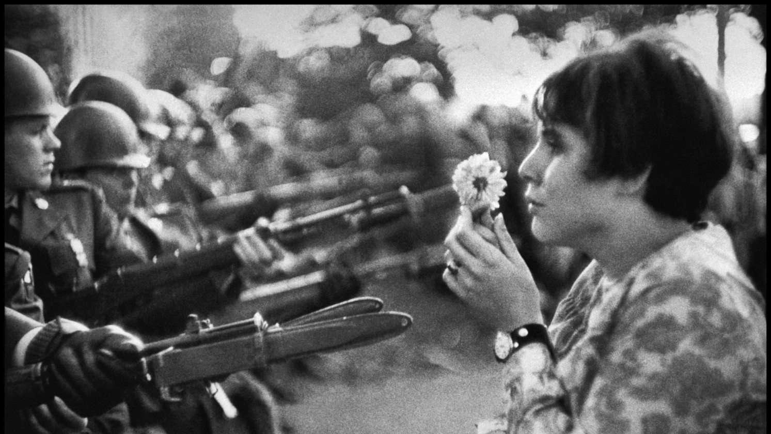
Our aspiration - enable peaceful and effective demonstrations
Help participants to clarify crucial questions before a demonstration:
What kind of repression tools might be used?
How can better tactics and messages be employed to avoid escalation?
Where are the most suitable locations?
Will the expected size of the crowd pose a problem?

Slide 6
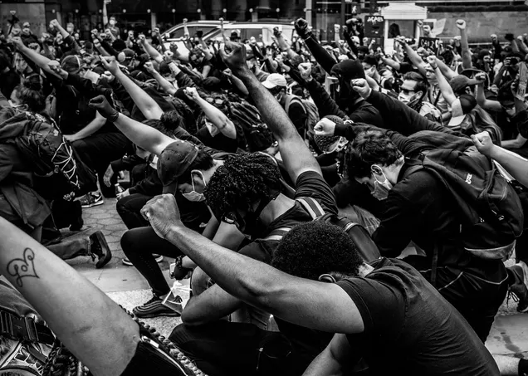
Methodology

Slide 7
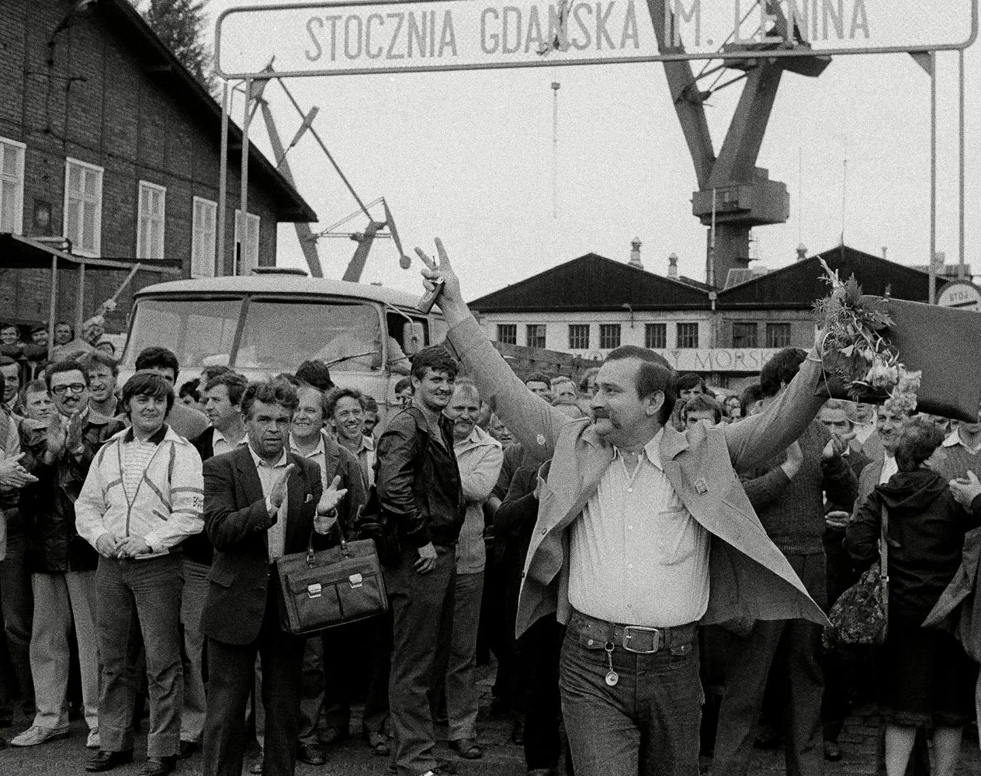
Where did we start?
Data sets of 3 different countries
An understanding of our eventual target variable
A rough idea what model to use
More than 100 features per set, some self-correlated, some unique…

Slide 8
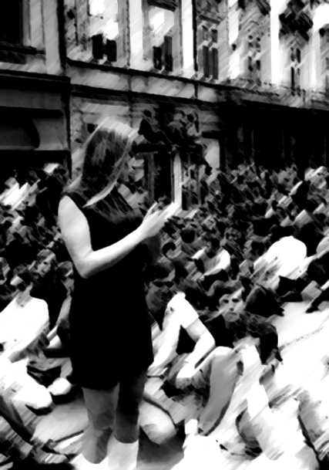




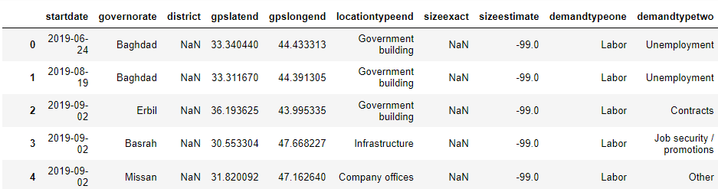
Creating a combined data frame of >13k records

Slide 9
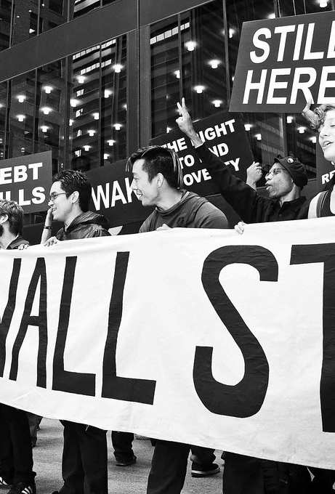


'
Flow Chart and Architecture
['represstiontype']
y: Target
y: Prediction
X: Feature Selection
['country','governorate','locationtypeend','demandtypeone','tacticprimary','violence','combined_sizes']

Slide 10
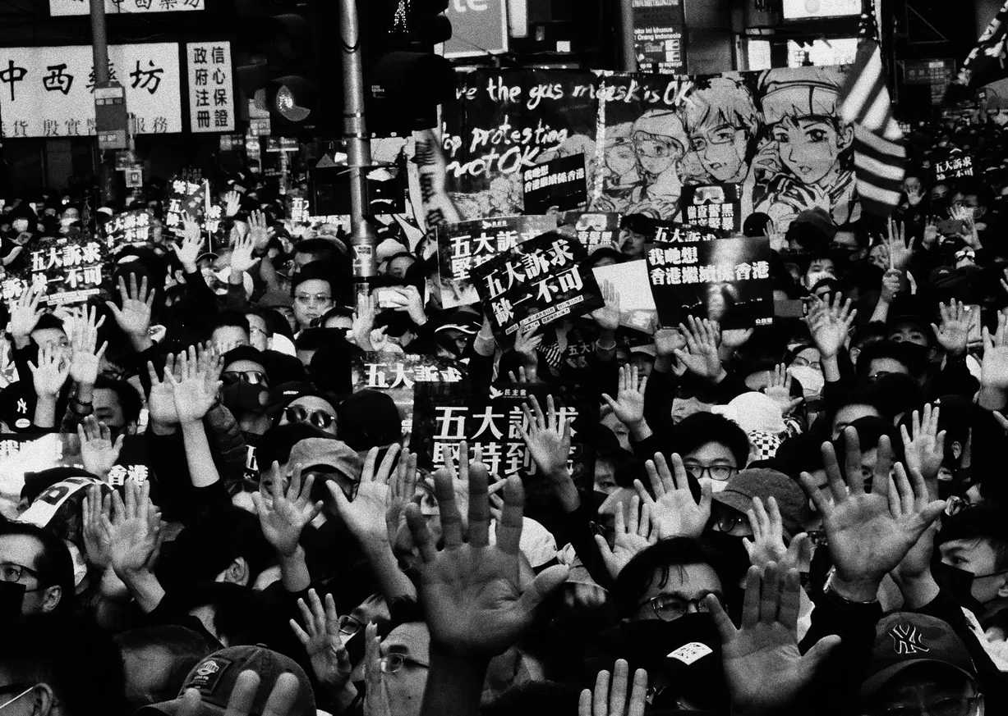
General Insights

Slide 11
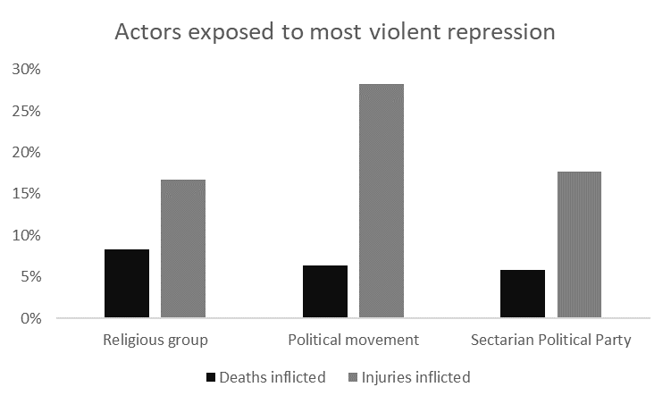
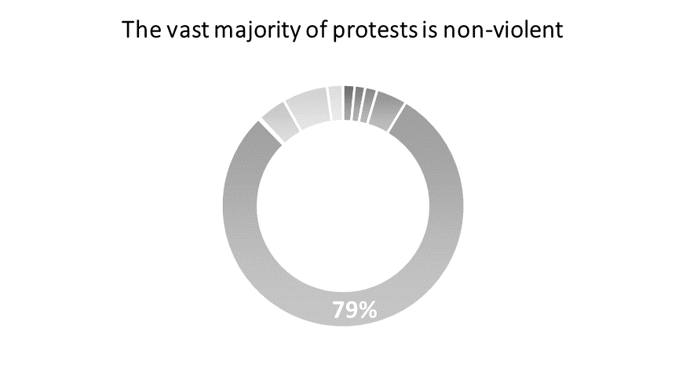
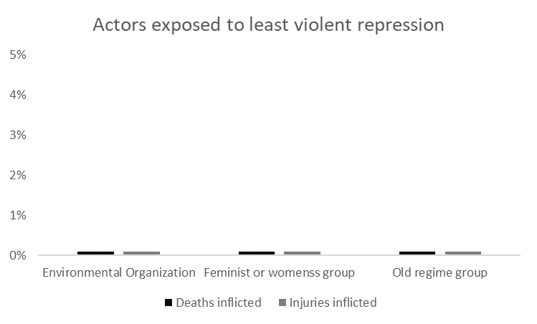
Protests challenging the existing political or religious order are at most risk

Slide 12
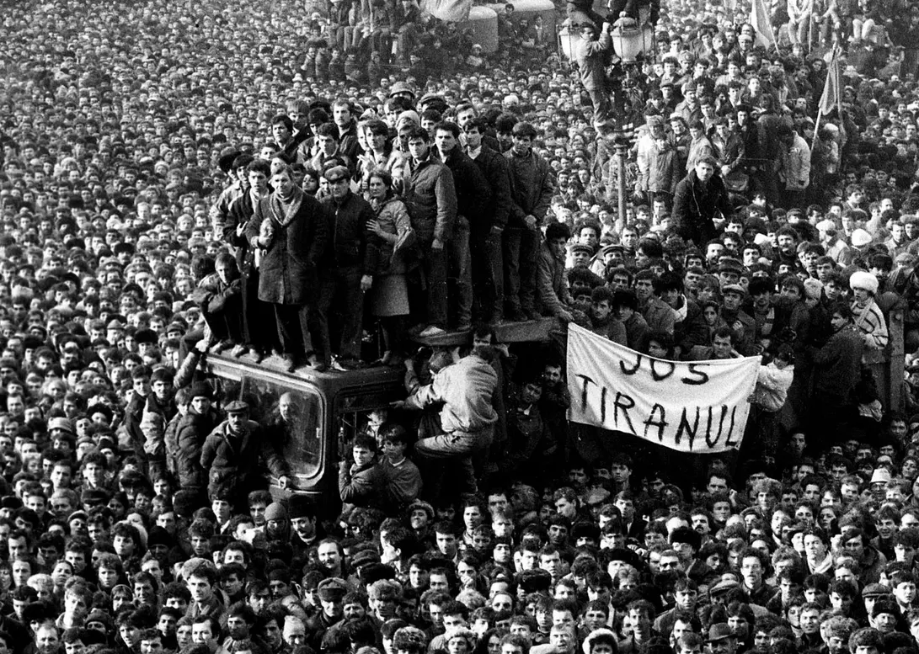
Showcase

Slide 13
Predict in Production/ Showcase (1-2 min)
Here we will show our model. Link to our web app
Predict from phon/ QR code?
Let people from the crowd draw input/ feature factors and do a „random“ prediction

Slide 14
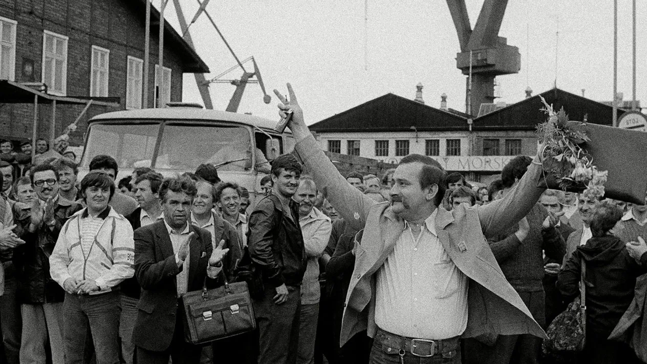
Thank you!
Outro
„If liberty means anything at all, it means the right to tell people what they do not want to hear.“

